Slide 1

Curs 13
Click School
5/7 decembrie 2022

Slide 2

Standup
#weareclickschool

Slide 3
Quiz
#weareclickschool

Slide 4
Fun exercises
Doja Cat CSS Video (https://dojacode.com/)
Flexbox Froggy (https://flexboxfroggy.com/)
CSS Grid Garden (https://cssgridgarden.com/)
Useful links:
https://developer.mozilla.org/en-US/docs/Web/CSS/CSS_Flexible_Box_Layout/Basic_Concepts_of_Flexbox
https://developer.mozilla.org/en-US/docs/Web/CSS/CSS_Grid_Layout/Basic_Concepts_of_Grid_Layout
#weareclickschool

Slide 5

AGENDĂ
Ce e un UI framework
Opțiuni
Cum adaugăm un CSS framework în proiect
Cum implementam un layout responsive
#weareclickschool

Slide 6
CSS Frameworks!
#weareclickschool

Slide 7
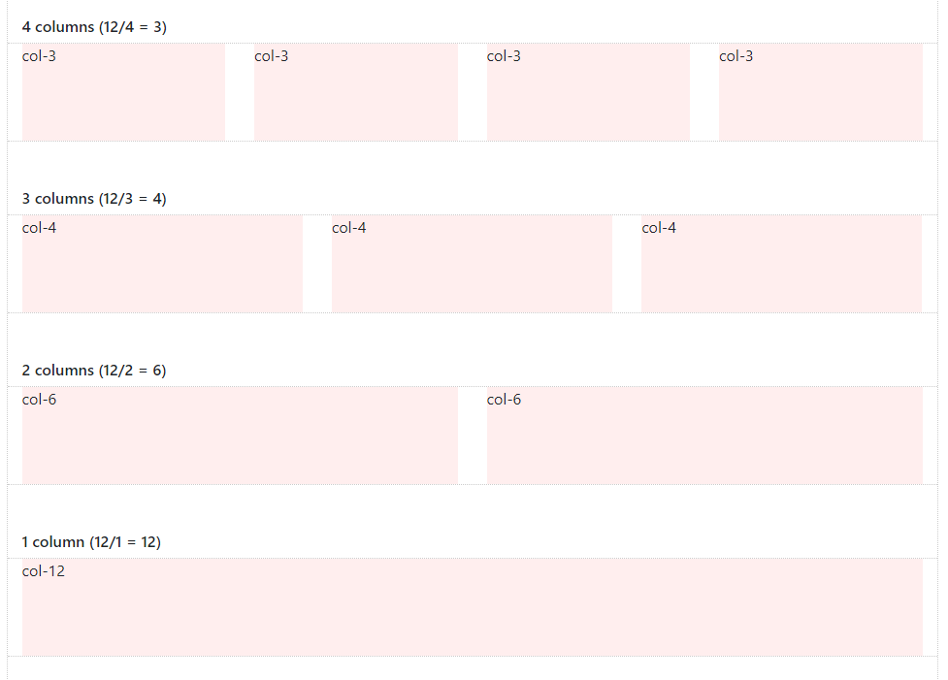
De ce sa folosim un framework?
Salveaza timp
Usor de folosit
Bine cunoscut
Responsive
Consistent
Comunitate
#weareclickschool

Slide 8
Optiuni Framework
Bootstrap
Materialize
Foundation
Tailwind
#weareclickschool

Slide 9
Cum folosim un CSS framework?
#weareclickschool

Slide 10

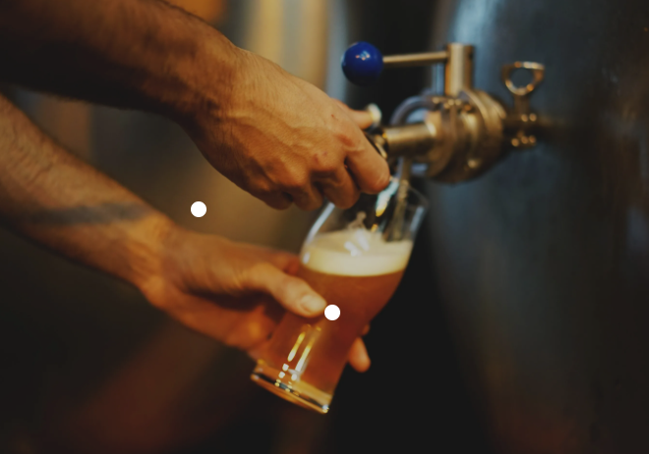
Pauză
#weareclickschool

Slide 11
Exercitii
Adaugati Bootstrap in proiect si folositi un component Button
Adaugati Tailwind in proiect si folositi un stilizati un card
#weareclickschool

Slide 12

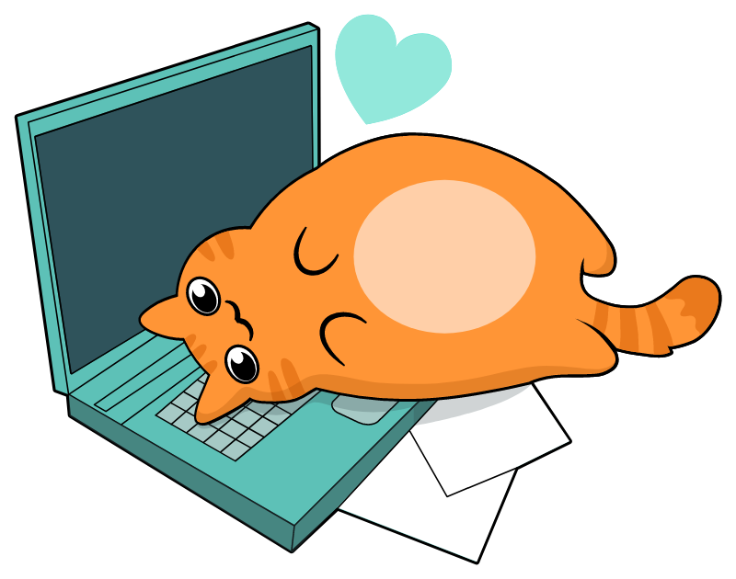
Exerciții
#weareclickschool

Slide 13
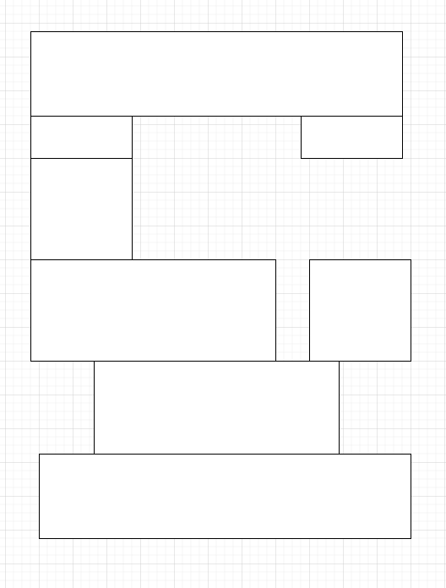
Exerciții
Creati o pagina noua
HTML cu urmatorul layout
pentru marime large (lg):
#weareclickschool

Slide 14
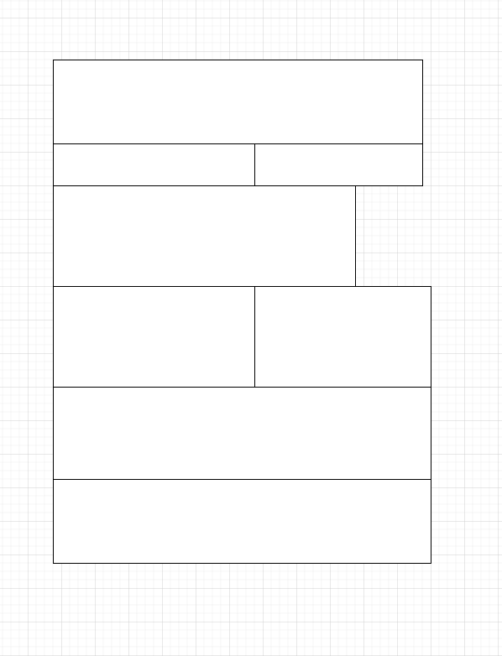
Exerciții
Creati o pagina noua
HTML cu urmatorul layout
pentru marime small (sm):
#weareclickschool

Slide 15
Final thoughts
Întrebări, feedback
#weareclickschool

